Slide 1
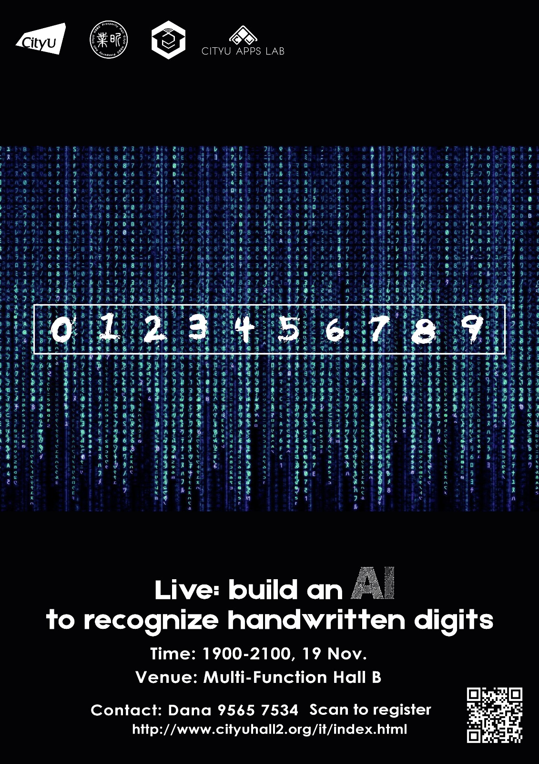

Slide 2

goo.gl/oMjkBB

Slide 3
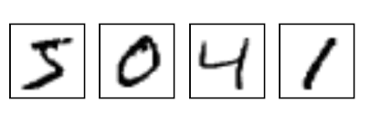


Build an AI to Recognize Digits
caffe.berkeleyvision.org
github.com/BVLC/caffe
Speaker: Jerry, Oliver
Adapted from Evan Shelhamer, Jeff Donahue, Jon Long
Embedded Vision Alliance Tutorial – © Shelhamer, Donahue, Long

Slide 4

Tutorial Organization
Deep learning (40 min)
Why deep learning?
What is deep learning?
Deep learning in computer vision (CNN)
LeNet & MNIST
Caffe
Demo: how to solve MNIST problem (60 min)
Deploy of LeNet {Data, Convolution, Pooling, FC, Loss}
Write prototxt in Netscope (train/validation)
Train network and log explanation (loss update)
Result analysis
Plot loss curve
Test final result
Visualize prediction
Looking beyond (20 min)
Cutting-edge applications
Learning guidance
Sharing: experience as an AI researcher

Slide 5

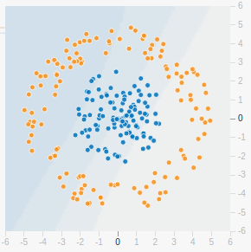
Before we start: Binary Classification
Let’s go non-linear on a classification problem
Try It Out

Slide 6
Tutorial Organization
Deep learning (40 min)
Why deep learning?
What is deep learning?
Deep learning in computer vision (CNN)
LeNet & MNIST
Caffe
Demo: how to solve MNIST problem (60 min)
Deploy of LeNet {Data, Convolution, Pooling, FC, Loss}
Write prototxt in Netscope (train/validation)
Train network and log explanation (loss update)
Result analysis
Plot loss curve
Test final result
Visualize prediction
Looking beyond (20 min)
Cutting-edge applications
Learning guidance
Sharing: experience as an AI researcher

Slide 7

How do computers see images
[figure adapted from A. Karpathy]
Notes:
it is hard to appreciate the challenge of recognition given our own expertise!
we automatically perceive, but the machine has to recognize from what is sensed
machine recognition is learned from a mere array of data

Slide 8
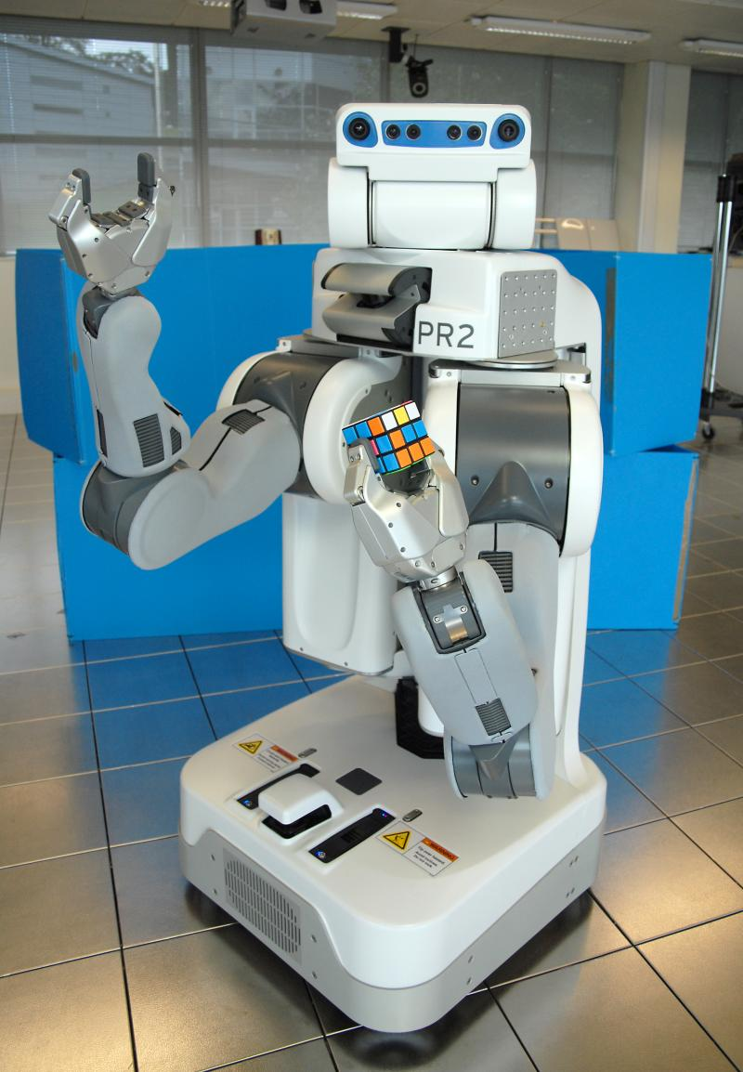
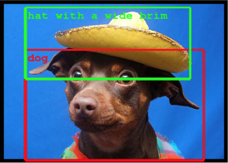

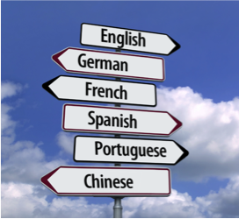
Why Deep Learning? End-to-End Learning for Many Tasks
vision
speech
text
control
Notes:
deep learning has proven useful for many purposes and not just one single task
this is the point of the learning end-to-end, that is, learning the whole problem from input to output: the same toolkit can work for different domains whether vision, speech, text, or control and robotics
we’ll focus on vision, and next we’ll look at core visual recognition tasks and the standard benchmarks for each problem.
deep learning approaches have delivered dramatic improvements across these and many other tasks.

Slide 9
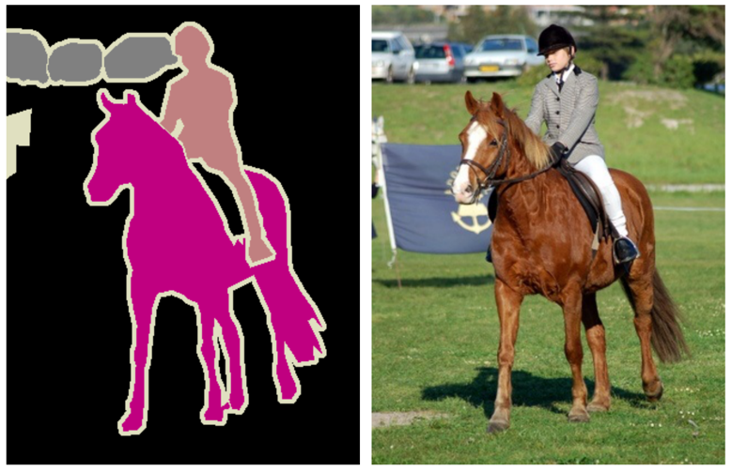

Why Deep Learning?
Task: Classification
what kind of image?
which kind(s) of objects?
Challenges
appearance varies by lighting, pose, context, ...
clutter
fine-grained categorization (horse or exact species)
dog
car
horse
bike
cat
bottle
person
Notes:
classification is the fundamental visual task of recognizing what is in an image or what type of image it is.
for example the kinds of objects in the image shown are car, horse, and person but we could also consider tasks like whether this is a daytime or nighttime image
classification is challenging because of the many differences in appearance seen in the visual world, like lighting, pose, style, and so on
clutter or noise can obscure the information to be extracted from the image
fine-grained categorization is a further difficulty when we want to recognize not just any horse but an exact species

Slide 10
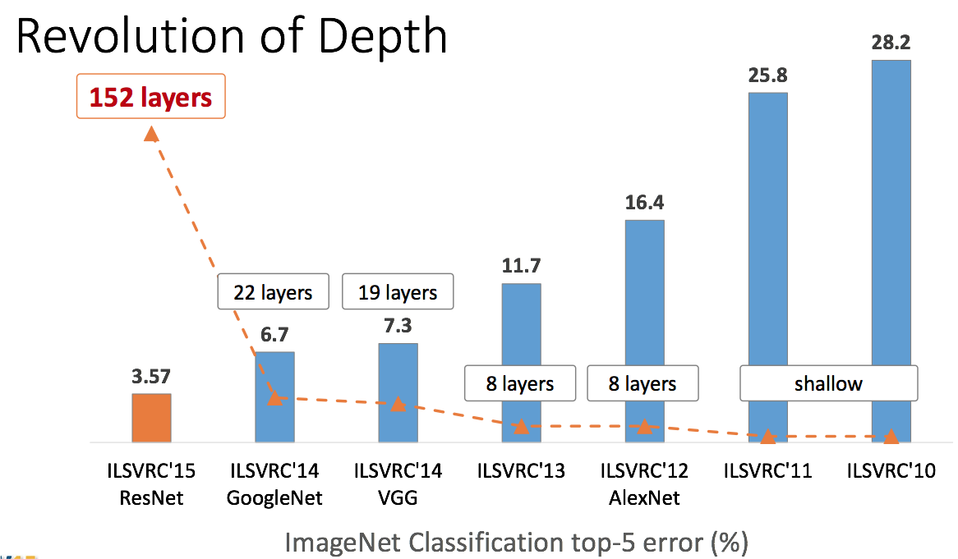
Image Classification: ILSVRC 2010-2015
dog
car
horse
bike
cat
bottle
person
top-5
error
[graph credit K. He]
Notes:
This graph shows the latest results as of the 2015 challenge with years running right to left
The introduction of deep learning not only dropped the error by almost 10 points in 2012, but deep learning methods have improved in accuracy every year
while networks are made deeper and deeper
many of the contest winners and runners-up were done with Caffe or reproduced with Caffe, including the latest winner (ResNet)
Mention speed as well as accuracy
Highlighted done in Caffe (ResNet, VGG) or reproduced in Caffe (GoogLeNet, AlexNet)

Slide 11
Why Deep Learning?
Task: Detection
what objects are there?
where are the objects?
Challenges
localization
multiple instances
small objects
car person horse
Notes:
detection is the task of recognizing not only what but where: both the identity and location of each object need to be predicted
while classification considered only presence or absence, detection demands the recognition of every instance as we see for all three cars
localization is difficult especially for interacting or articulated objects like the person and horse or for small objects that are easy to miss

Slide 12
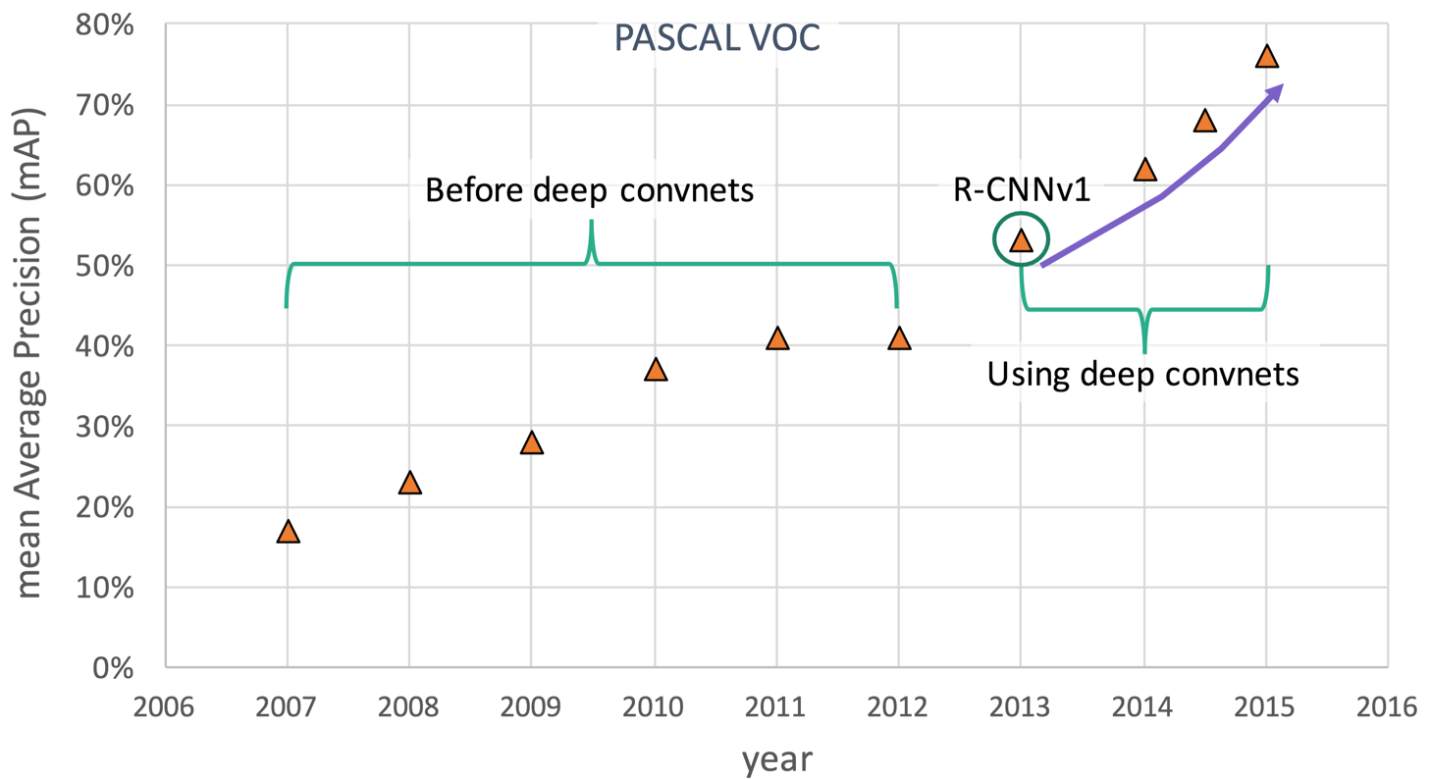
Detection: PASCAL VOC
detection accuracy
R-CNN:
regions +
convnets
state-of-the-art, in Caffe
[graph credit R. Girshick]
Notes:
deep learning is likewise having a remarkable impact on detection
PASCAL VOC is a gold standard dataset and challenge with fierce competition
detection accuracy scores both recognition and localization
by 2012 progress had slowed and plateaued only to be driven further by the adoption of deep learning
R-CNN
Gloss mean AP as “detection accuracy” == a measure of recognition and localization
gold standard for detection. drove the data set + challenge shift in computer vision. successor is COCO

Slide 13
Why Deep Learning?
Task: Semantic Segmentation
what kind of thing is each pixel part of?
what kind of stuff is each pixel?
Challenges
tension between recognition and localization
amount of computation
car
person
horse
Notes:
semantic segmentation is a visual recognition task that asks the identity of every pixel
for things this means what kind of object is the pixel part of, as in this example output that shows which are the horse pixels and which are the person pixels
we could just as well ask for what kind of stuff each pixel is, such as grass or sky, or in the context of a satellite image there might be road, buildings, crops, water, and so forth.
in this task there is a tension between recognizing what globally and where locally
computational cost can be an obstacle now that there is a decision to be made for every pixel

Slide 14
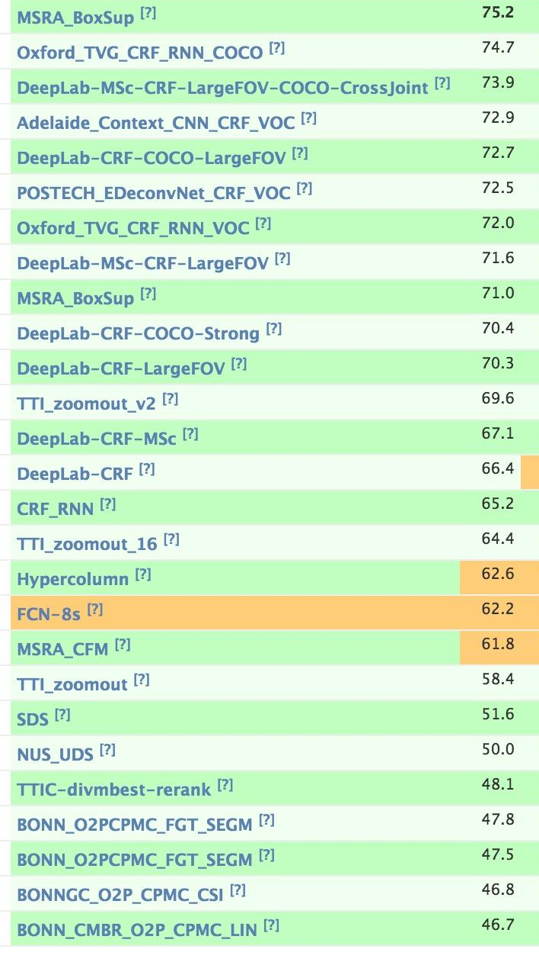
Segmentation: PASCAL VOC
Leaderboard
deep learning with Caffe end-to-end networks lead to
30 points absolute or 50% relative improvement
and >100x speedup in 1 year!
(papers published for +1 or +2 points)
car
per-
son
horse
FCN:
pixelwise convnet
state-of-the-art, in Caffe
Notes:
the same data set includes the most popular semantic segmentation challenge
since the switch to deep learning, end-to-end networks have delivered a 50% relative improvement in accuracy and >100x speedup in only a year
progress in classification, detection, and segmentation is currently driven by deep learning

Slide 15
Tutorial Organization
Deep learning (40 min)
Why deep learning?
What is deep learning?
Deep learning in computer vision (CNN)
LeNet & MNIST
Caffe
Demo: how to solve MNIST problem (60 min)
Deploy of LeNet {Data, Convolution, Pooling, FC, Loss}
Write prototxt in Netscope (train/validation)
Train network and log explanation (loss update)
Result analysis
Plot loss curve
Test final result
Visualize prediction
Looking beyond (20 min)
Cutting-edge applications
Learning guidance
Sharing: experience as an AI researcher

Slide 16
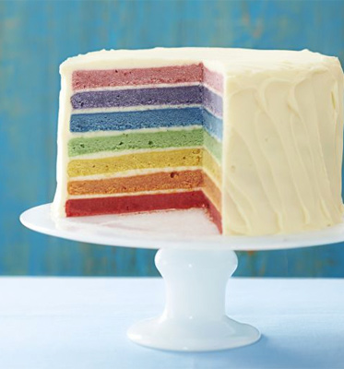
What is deep learning
Deep Learning is
Stacking Layers
&
Learning End-to-End

Slide 17
What is a layer?
A layer is a transformation
x’ = layer(x)
Deep networks are layered models made by stacking different types of transformation
x₂ = layer₁(x₁)
x₃ = layer₂(x₂)
...
How do layers stack?
Notes:
note: animated

Slide 18
What is a network?
Networks run layer-by-layer, composing
the input-output transformation of each layer
output
output
output + error
output
x₁
out
= layer₁(input)
= layer₂(x₁)
layer₂
layer₂
layer₂
During learning, the error is passed back
layer-by-layer to tune the transformations
layer₁
layer₁
layer₁
input
What kind of layers should we stack?
input
input

Slide 19
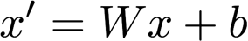
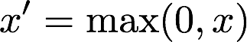
The Simplest Layers
Matrix Multiplication
Non-linearity
(for example)

Slide 20

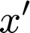
Matrix Multiplication
Multiply input x by weights W and add bias b
Learns linear transformations
K x O dimensional
K inputs
O outputs
O outputs

Slide 21
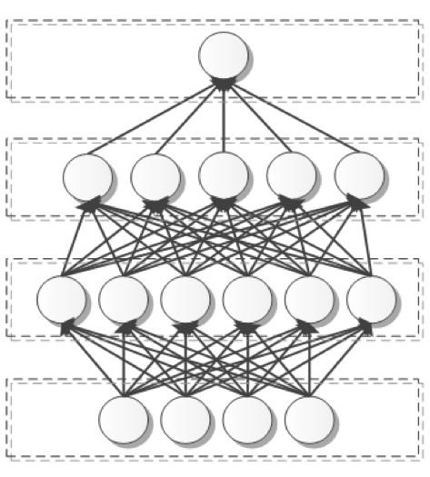

Matrix Multiplication == Fully Connected Layer
Output is a function of every input, or the input and output are “fully connected”
Abbreviated as FC
[figure credit BDTI]

Slide 22
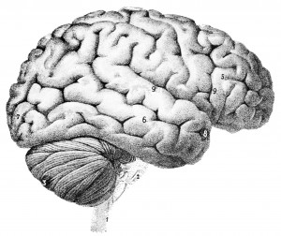
Not So “Neural”
This isn’t a problem (except for neuroscientists)
Be wary of neural realism hype or “it just works because it’s like the brain”
network, not neural network unit, not neuron
These models are not how the brain works
We don’t know how the brain works!
Notes:
for-real edition of “it works because”:
more data/supervision
more of the model is made learnable

Slide 23
Linear Classification
To classify we need to separate the data into red vs. blue
x₂
Suppose our data points (x) are 2D and each comes with a label y, where y = -1 or y = 1
Learn a weight vector w = [w₁; w₂]
Predict the class of a given x by sign(w^{T}x) = sign(w₁x₁ + w₂x₂)
y = -1
y = 1
x₁
?
Notes:
armed with matrix multiplication we can do linear classification
separate the data into red vs. blue
the data x is 2-dimensional, with axes x1 and x2 while the output y is simply -1 / red or +1 / blue
learn weights w1 and w2 to weight x1 and x2 to represent a separating line
what line?

Slide 24
Linear Classification
To classify we need to separate the data into red vs. blue
x₂
Suppose our data points (x) are 2D and each comes with a label y, where y = -1 or y = 1
Learn a weight vector w = [w₁; w₂]
Predict the class of a given x by sign(w^{T}x) = sign(w₁x₁ + w₂x₂)
y = -1
y = 1
x₁
Notes:
armed with matrix multiplication we can do linear classification
separate the data into red vs. blue
the data x is 2-dimensional, with axes x1 and x2 while the output y is simply -1 / red or +1 / blue
learn weights w1 and w2 to weight x1 and x2 to represent a separating line
what line?

Slide 25
Linearity is Not Enough
To classify we need to separate the data into red vs. blue
x₂
y = -1
y = 1
?
x₁
Notes:
in practice linearity is not enough and real world data requires more sophisticated classifiers
what line separates this data? none
need non-linearity

Slide 26
Linearity is Not Enough
To classify we need to separate the data into red vs. blue
x₂
y = -1
y = 1
NO
x₁
Notes:
in practice linearity is not enough and real world data requires more sophisticated classifiers
what line separates this data? none
need non-linearity

Slide 27
Linearity is Not Enough
To classify we need to separate the data into red vs. blue
x₂
y = -1
y = 1
NO
x₁
Notes:
in practice linearity is not enough and real world data requires more sophisticated classifiers
what line separates this data? none
need non-linearity

Slide 28
Linearity is Not Enough
To classify we need to separate the data into red vs. blue
x₂
y = -1
y = 1
NO
x₁
Notes:
in practice linearity is not enough and real world data requires more sophisticated classifiers
what line separates this data? none
need non-linearity

Slide 29
Linearity is Not Enough
To classify we need to separate the data into red vs. blue
x₂
y = -1
y = 1
YES
x₁
Non-linearity!
Notes:
in practice linearity is not enough and real world data requires more sophisticated classifiers
what line separates this data? none
need non-linearity

Slide 30
Linearity is Not Enough
To classify we need to separate the data into red vs. blue
x₂
y = -1
y = 1
YES
x₁
Non-linearity!
Notes:
in practice linearity is not enough and real world data requires more sophisticated classifiers
what line separates this data? none
need non-linearity

Slide 31
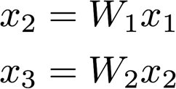
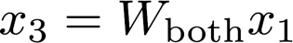

The Limits of Linearity
Linear steps collapse and stay linear
Linear layers alone do not meaningfully stack

Slide 32
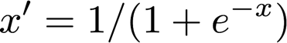
Non-linearity
ReLU
Sigmoid
Non-linearity is needed to deepen the representation
Many non-linearities or activations to choose from
Notes:
Pointwise non-linearities

Slide 33
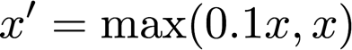
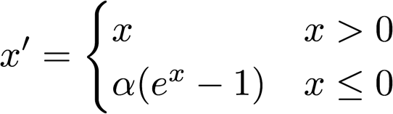
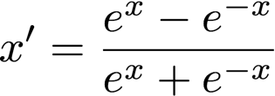
Yet More Non-linearities
ReLU
Leaky ReLU
Sigmoid
ELU
TanH
When in doubt, ReLU
Worth trying Leaky ReLU, ELU
Avoid Sigmoid

Slide 34
Second Try: Binary Classification
Now you might have a better understanding of what’s going on behind.
Try It Out Again

Slide 35
Tutorial Organization
Deep learning (40 min)
Why deep learning?
What is deep learning?
Deep learning in computer vision (CNN)
LeNet & MNIST
Caffe
Demo: how to solve MNIST problem (60 min)
Deploy of LeNet {Data, Convolution, Pooling, FC, Loss}
Write prototxt in Netscope (train/validation)
Train network and log explanation (loss update)
Result analysis
Plot loss curve
Test final result
Visualize prediction
Looking beyond (20 min)
Cutting-edge applications
Learning guidance
Sharing: experience as an AI researcher

Slide 36

1.3 Deep Learning in Computer Vision
Convolutional Networks or convnets are nets for vision
functional fit for the visual world by compositionality and feature sharing
learned end-to-end to handle visual detail for more accuracy and less engineering
Convnets are the dominant architectures for visual tasks
TL DR: We will use convnet to recognize digits

Slide 37
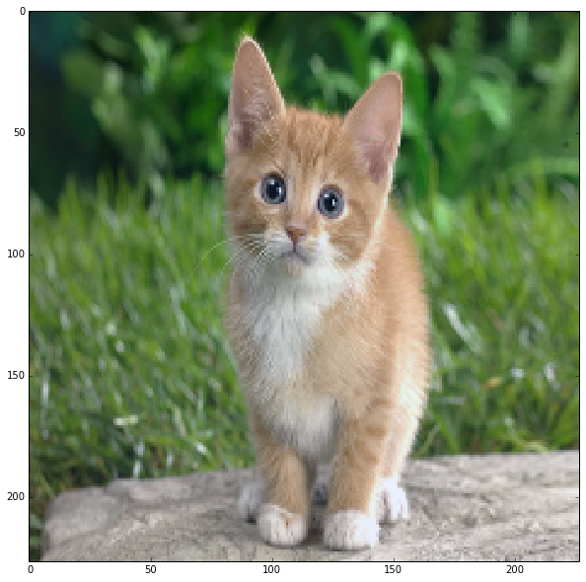
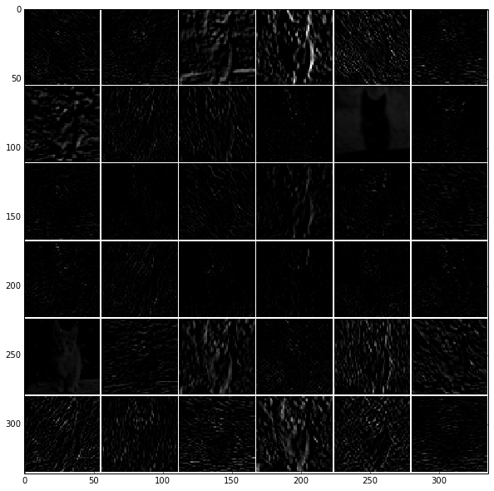
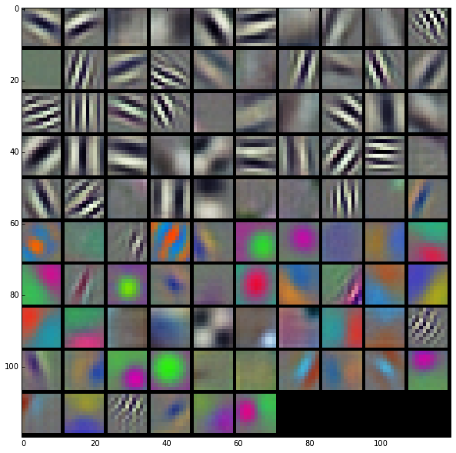
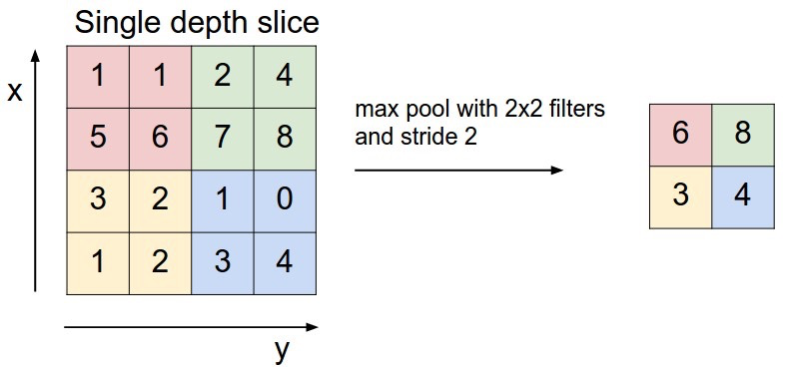
Vision Layers
Learned Filter
Convolution/Filtering
linear layer for vision
Pooling
spatial summarization
max pool 2x2
with stride 2
[figure credit A. Karpathy, cs231n course]

Slide 38
Matrix Multiplication == Fully Connected Layer
Output is a function of every input, or the input and output are “fully connected”
Abbreviated as FC
[figure credit BDTI]

Slide 39
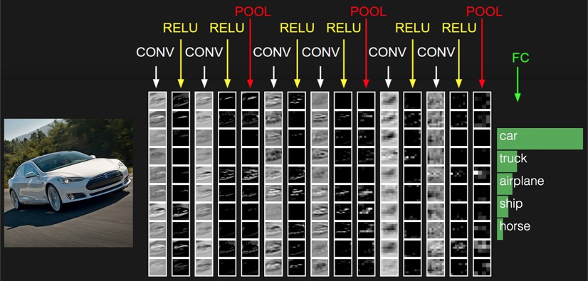
Convnet Architecture
Stack convolution, non-linearity, and pooling until global FC layer classifier
Conv 3x3s1, 10 / ReLU
Type: Conv Kernel Size: 3x3 Stride: 1 Channels:10 Activation: ReLU
FC 10
Max Pool 3x3s1
Conv 3x3s1, 10 / ReLU
Conv 3x3s1, 10 / ReLU
Max Pool 3x3s1
Conv 3x3s1, 10 / ReLU
Conv 3x3s1, 10 / ReLU
Max Pool 3x3s1
Conv 3x3s1, 10 / ReLU
Input Image
Scores
Conv 3x3s1, 10 / ReLU
http://cs231n.stanford.edu/
[figure credit A. Karpathy]

Slide 40
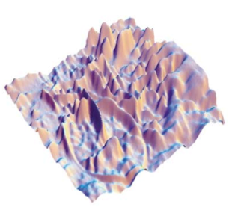
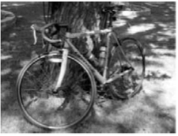
How do computers see images
Machine Recognition
What does this pattern depict?
Same data!
intensity as elevation
intensity as brightness
[Kersten & Yuille, 2003]
Notes:
it is hard to appreciate the challenge of recognition given our own expertise!
we automatically perceive, but the machine has to recognize from what is sensed
machine recognition is learned from a mere array of data

Slide 41
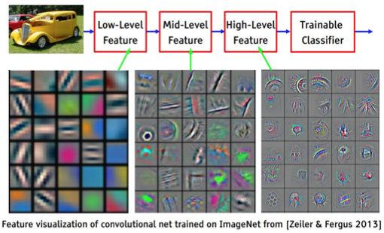
What Does a Deep Net Learn?
[figure credit Y. LeCun, ICML13 tutorial]

Slide 42
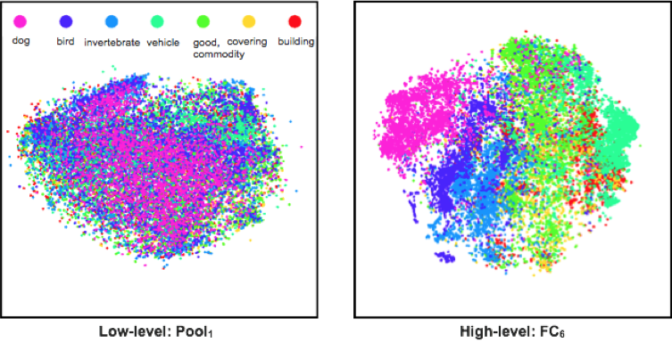
Feature Embedding The Unreasonable Effectiveness of Deep Features
Classes separate in the deep representations and transfer to many tasks. [DeCAF] [Zeiler-Fergus]
Notes:
These visualizations embed high dimensional features into 2D so that points that are close in image are close in the feature space.
That is, distances are preserved so that similar features end up close together and dissimilar features end up wherever.
Point out lack of structure in shallow feature (pool1)
Point out class structure in deep feature (fc6) and even super-class structure with animals clustered together

Slide 43
Convnet Architecture
Stack convolution, non-linearity, and pooling until global FC layer classifier
Conv 3x3s1, 10 / ReLU
Type: Conv Kernel Size: 3x3 Stride: 1 Channels:10 Activation: ReLU
FC 10
Max Pool 3x3s1
Conv 3x3s1, 10 / ReLU
Conv 3x3s1, 10 / ReLU
Max Pool 3x3s1
Conv 3x3s1, 10 / ReLU
Conv 3x3s1, 10 / ReLU
Max Pool 3x3s1
Conv 3x3s1, 10 / ReLU
Input Image
Scores
Conv 3x3s1, 10 / ReLU
http://cs231n.stanford.edu/
[figure credit A. Karpathy]

Slide 44
Tutorial Organization
Deep learning (40 min)
Why deep learning?
What is deep learning?
Deep learning in computer vision (CNN)
LeNet & MNIST
Caffe
Demo: how to solve MNIST problem (60 min)
Deploy of LeNet {Data, Convolution, Pooling, FC, Loss}
Write prototxt in Netscope (train/validation)
Train network and log explanation (loss update)
Result analysis
Plot loss curve
Test final result
Visualize prediction
Looking beyond (20 min)
Cutting-edge applications
Learning guidance
Sharing: experience as an AI researcher

Slide 45

See a Net Learn to See
Let’s watch a convnet as it learns
how to recognize objects in images
Try It Out

Slide 46

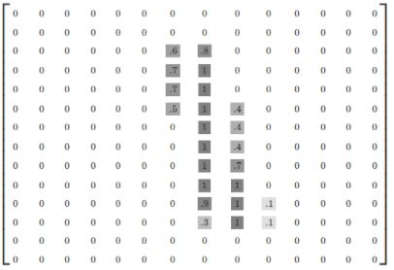
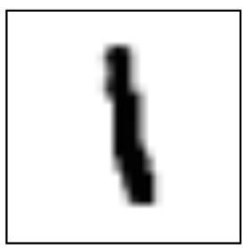
MNIST
Handwritten digits with labels
Split into three parts:
- 55,000 data points of training data
- 10,000 points of test data
- 5,000 points of validation data
Each image is 28 pixels by 28 pixels.
Can be interpreted as a big array of numbers, and flattened into a vector of 28 * 28 = 784 dims.

Slide 47
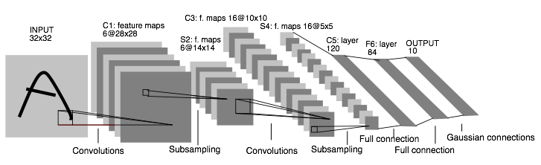
First Convolutional Networks: 1989
LeNet: a layered model composed of convolution and subsampling layers followed by a holistic representation and ultimately a classifier for handwritten digits [LeNet]
Note: channel dimension goes up as spatial dimension goes down...
still a common pattern today

Slide 48
Learning LeNet
FC 10
FC 500 / ReLU
Max Pool 2x2s2
Conv 5x5s1, 50
Max Pool 2x2s2
Conv 5x5s1, 20
our LeNet in 60 seconds
The original LeNet: a typical conv-pool to FC architecture in 1989 style with small channel dimensions and sigmoid non-linearity
Define, train, and test a handwritten digit classifier like the famous LeNet convnet [LeNet]

Slide 49
Tutorial Organization
Deep learning (40 min)
Why deep learning?
What is deep learning?
Deep learning in computer vision (CNN)
LeNet & MNIST
Caffe
Demo: how to solve MNIST problem (60 min)
Deploy of LeNet {Data, Convolution, Pooling, FC, Loss}
Write prototxt in Netscope (train/validation)
Train network and log explanation (loss update)
Result analysis
Plot loss curve
Test final result
Visualize prediction
Looking beyond (20 min)
Cutting-edge applications
Learning guidance
Sharing: experience as an AI researcher

Slide 50
1.4 First Sip of Caffe
We’ll be using Caffe for our hands-on experience
see notebook

Slide 51

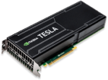
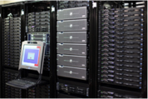
1.4 First Sip of Caffe
Open framework, models, and worked examples for deep learning
Pure C++ / CUDA architecture for deep learning
Command line, Python, MATLAB interfaces
Fast, well-tested code
Tools, reference models, demos, and recipes
Seamless switch between CPU and GPU
Prototype
Train
Deploy

Slide 52
Model Format: Protobuf
layer {
name: "conv1"
type: "Convolution"
bottom: "data"
top: "conv1"
convolution_param {
num_output: 20
kernel_size: 5
stride: 1
weight_filler {
type: "xavier"
}
}}
Strongly typed format
Auto-generates code
Developed by Google
Defines Net / Layer / Solver schemas in caffe.proto
message ConvolutionParameter {
// The number of outputs for the layer
optional uint32 num_output = 1;
// whether to have bias terms
optional bool bias_term = 2 [default = true];
}

Slide 53

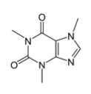

Coffee Break (5 minutes)
caffe.berkeleyvision.org
github.com/BVLC/caffe

Slide 54
Net
FC 1000
A network is a set of layers and their connections:
FC 4096
name: "dummy-net"
layer { name: "data" …}
layer { name: "conv" …}
layer { name: "pool" …}
… more layers …
layer { name: "loss" …}
FC 4096
Max Pool
Conv 256
Conv 384
Conv 384
FC 10
Max Pool
FC 500
LRN
Caffe creates and checks the net from the definition.
Data and derivatives flow through the net as blobs – an array interface
Max Pool
Conv 256
Conv 50
Max Pool
Max Pool
LRN
FC 2
Conv 20
Conv 96
LogReg
LeNet
AlexNet

Slide 55
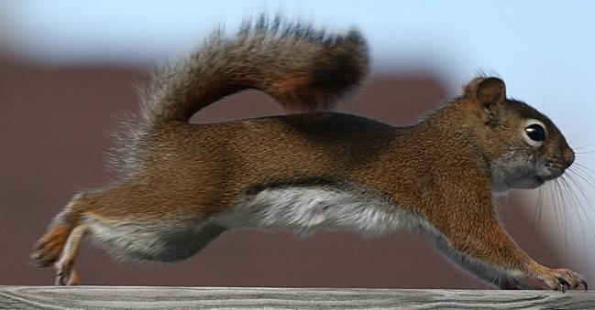
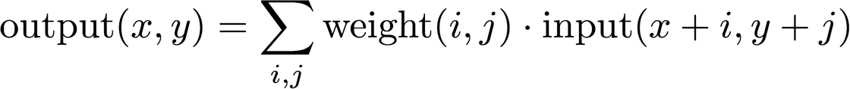
Convolution: A Linear Layer for Vision
Images have translation invariant semantics: these are all equally squirrels
So use the same weights between nodes with the same spatial relationship
This is convolution (or correlation—used interchangeably in vision)
Convolution means fewer parameters for more efficient learning
Notes:
use the same weights for the same spatial relationship

Slide 56
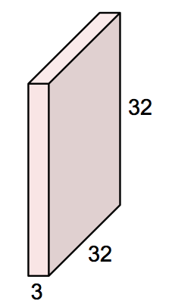
A Filter
A filter is a spatially local and cross-channel template
Convnet filters are learned
input is 3x32x32 data a color image (3 RGB channels) and square (32x32)
[figure adapted from A. Karpathy]

Slide 57

A Filter
A filter is a spatially local and cross-channel template
Convnet filters are learned
input is 3x32x32 data a color image (3 RGB channels) and square (32x32)
filter is 3x5x5 weights
spatially local: kernel size is 5x5
cross-channel: connected across all input channels
[figure adapted from A. Karpathy]

Slide 58
A Filter
A filter is a spatially local and cross-channel template
Convnet filters are learned
input is 3x32x32 data a color image (3 RGB channels) and square (32x32)
filter is 3x5x5 weights
spatially local: kernel size is 5x5
cross-channel: connected across all input channels
total parameters: 3*5² = 75 filter weights + 1 bias
[figure adapted from A. Karpathy]

Slide 59
Convolution
One filter evaluation is a dot product between the input window and weights + bias
input
filter
bias
output
3x32x32
3x5x5
1
1
32
[figure adapted from A. Karpathy]
Notes:
weights are shared across space

Slide 60
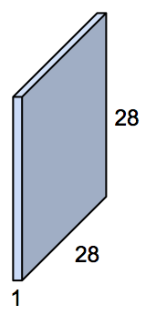
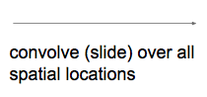
Convolution
Convolving the filter with the input gives a feature map.
input
filter
bias
output
3x32x32
3x5x5
1
1
feature map
32
1x28x28
[figure adapted from A. Karpathy]
Notes:
weights are shared across space

Slide 61
Convolution
Convolving the filter with the input gives a feature map.
input
filter
bias
output
3x32x32
3x5x5
1
1
feature map
32
1x28x28
Filter parameters:
FC parameters:
3*5² = 75
3*32² = 3,072
[figure adapted from A. Karpathy]
Notes:
weights are shared across space

Slide 62
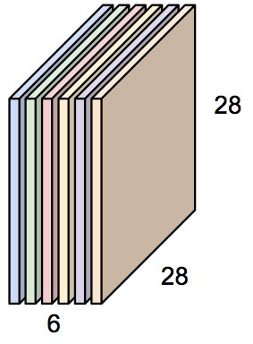
Convolution Layer (conv)
Convolution layers have multiple filters for more modeling capacity
input
filters
bias
output
3x32x32
6x3x5x5
6
6x28x28
feature maps
32
Convolution Layer
[figure adapted from A. Karpathy]

Slide 63
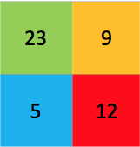
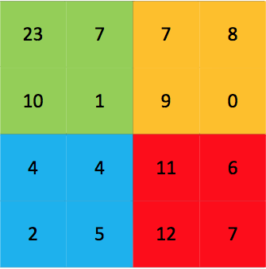
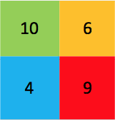
Pooling (pool)
Spatial summary by computing operation over window with stride
overlapping or non-overlapping
separate across channels
Current fashion: 3x3 max pooling with stride 2
Max pooling
2x2 pooling, stride 2
Average pooling
[figure credit BDTI]

Slide 64
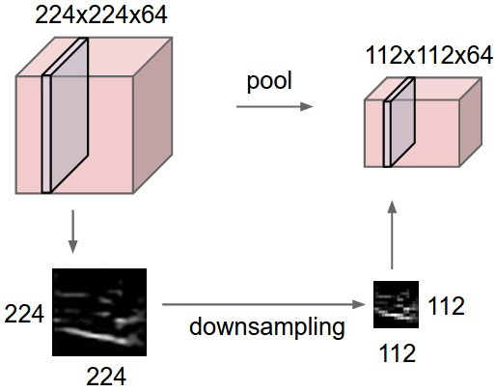
Pooling
64x224x224
64x112x112
reduce resolution
increase receptive field size for later layers
save computation
add invariance to translation/noise within pooling window
[figure credit A. Karpathy]

Slide 65
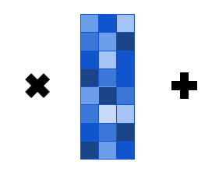
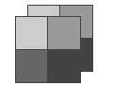



Fully Connected Layers (FC)
Learn a global feature from the full feature maps
Often found at the end of convnets
Note: this could likewise be done by a large convolution kernel
feature maps
2x2x2
bias
1 x 3
outputs or units
1 x 3
unroll
input
1 x 8
weights
8 x 3

Slide 66
Layer Review
layers compute differentiable transformations
types of layers: conv, ReLU, pool, FC
parameters (conv, FC) or not (pool, ReLU)
arguments like kernel size, stride, etc. (conv, pool) or not (Sigmoid)

Slide 67
Tutorial Organization
Deep learning (40 min)
Why deep learning?
What is deep learning?
Deep learning in computer vision (CNN)
LeNet & MNIST
Caffe
Demo: how to solve MNIST problem (60 min)
Deploy of LeNet {Data, Convolution, Pooling, FC, Loss}
Write prototxt in Netscope (train/validation)
Train network and log explanation (loss update)
Result analysis
Plot loss curve
Test final result
Visualize prediction
Looking beyond (20 min)
Cutting-edge applications
Learning guidance
Sharing: experience as an AI researcher

Slide 68
Part 2:
Hands-On Introduction to the Caffe Framework:
Brewing Networks with Caffe
caffe.berkeleyvision.org
github.com/BVLC/caffe
What is caffe?
Running a pre-trained network
Defining, learning, and testing networks
Fine-tuning for transfer learning
Embedded Vision Alliance Tutorial – © Shelhamer, Donahue, Long

Slide 69
Training LeNet on MNIST
Prepare Datasets
Define the MNIST Network and Solver
Training and Testing the Model
Result analysis

Slide 70
Prepare Datasets
THE MNIST DATABASE
mnist_train_lmdb
mnist_test_lmdb
a dataset of image with label

Slide 71
Define the MNIST Network
Netscope
Creating training and testing net from net file lenet_train_test.prototxt

Slide 72
Define the MNIST Solver
Initializing solver from parameters lenet_solver.prototxt

Slide 73
Training and Testing the Model
Network initialization
Solver scaffolding
Solving LeNet

Slide 74
Result analysis
Plot loss curve
Visualize prediction
Test final result

Slide 75
Tutorial Organization
Deep learning (40 min)
Why deep learning?
What is deep learning?
Deep learning in computer vision (CNN)
LeNet & MNIST
Caffe
Demo: how to solve MNIST problem (60 min)
Deploy of LeNet {Data, Convolution, Pooling, FC, Loss}
Write prototxt in Netscope (train/validation)
Train network and log explanation (loss update)
Result analysis
Plot loss curve
Test final result
Visualize prediction
Looking beyond (20 min)
Cutting-edge applications
Learning guidance
Sharing: experience as an AI researcher

Slide 76
Resources for learning Deep Learning
http://karpathy.github.io/neuralnets/
A Hacker’s guide to Deep Learning [suitable for experienced coders]
http://cs231n.stanford.edu/
Stanford computer vision and deep learning course. [Highly Recommended]
https://www.coursera.org/specializations/deep-learning
Andrew Ng’s course [Audit the course]
http://www.deeplearningbook.org/
Current best open-source book in deep learning written by three experts in Deep Learning. [Highly Recommended]
A deep learning framework: Caffe / PyTorch / TensorFlow (Keras)

Slide 77
Andrew Ng's Sharing on Being an AI expert

Slide 78


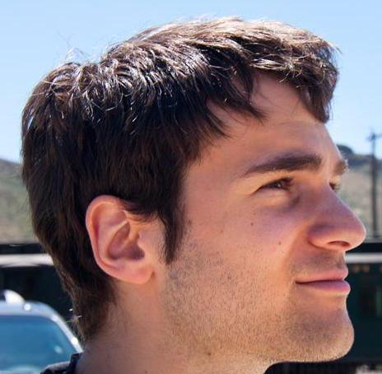





Thanks to the whole Caffe Crew
Yangqing Jia, Evan Shelhamer, Jeff Donahue, Jonathan Long, Sergey Karayev, Ross Girshick, Sergio Guadarrama, Ronghang Hu, Trevor Darrell
and our open source contributors!
Notes:
We should be around 4:55 pm at this point.
Jeff Bier will make a few minutes of concluding remarks.
There will be a 30 minutes Q&A at the end.
End around 5:30 pm.

Slide 79
END
Notes:
learning material, registration

Slide 80

Survey
https://goo.gl/forms/XrSchRZtHrivjXIn1

